Slide 1
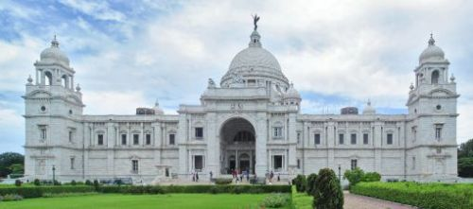
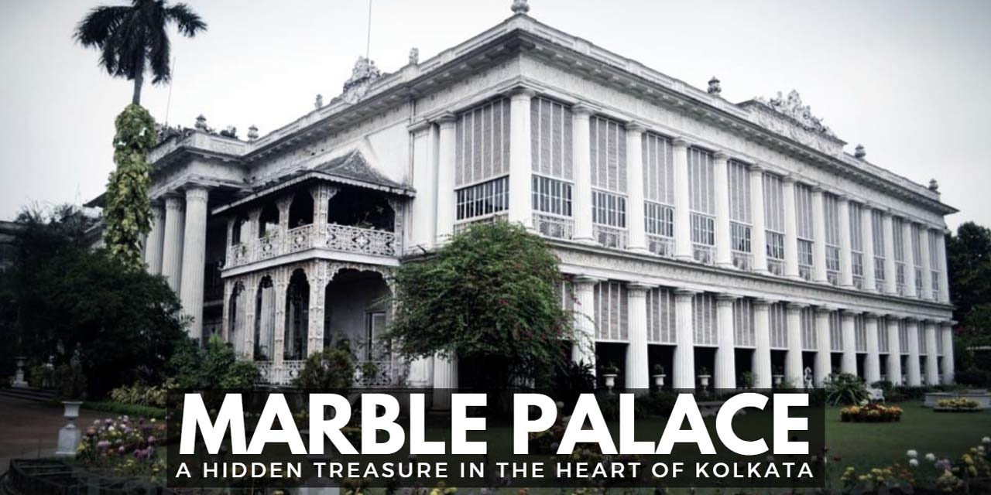
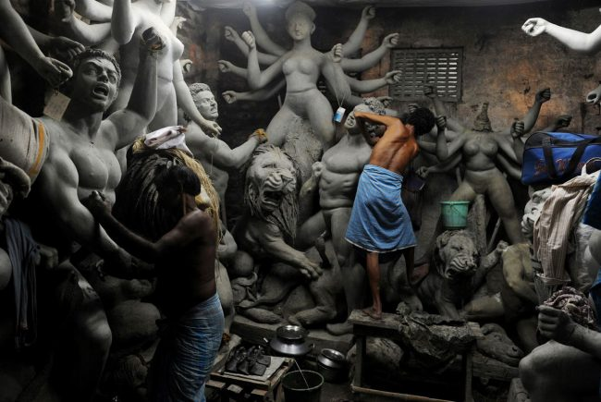
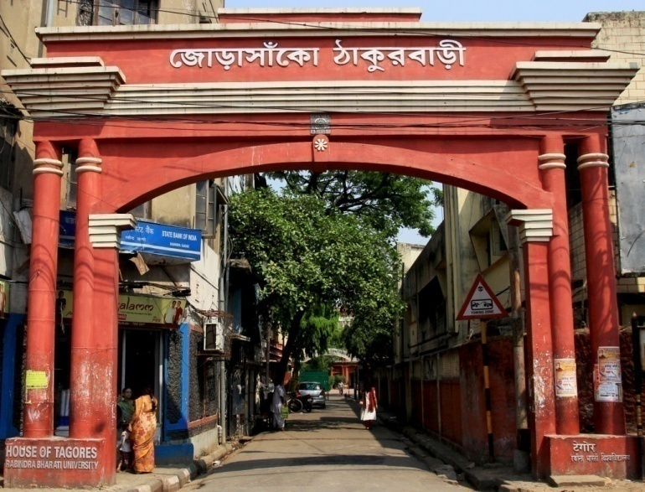
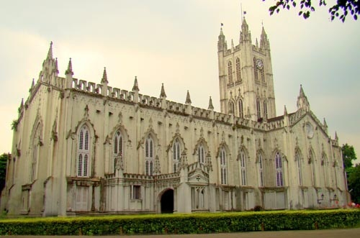
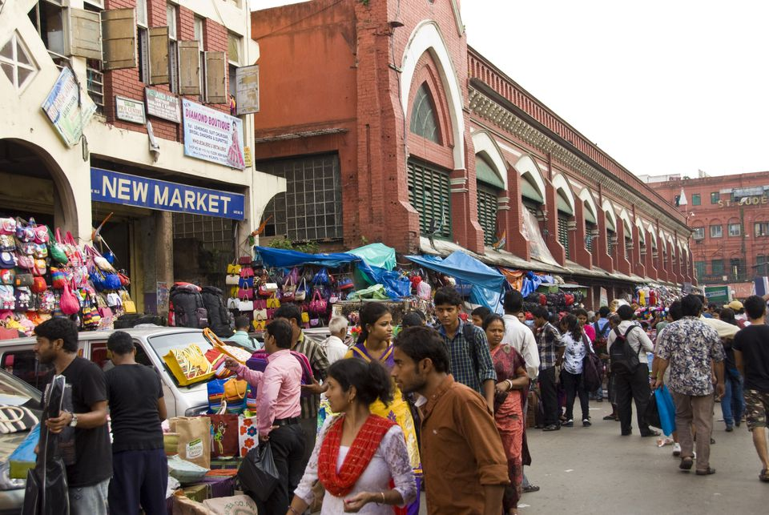
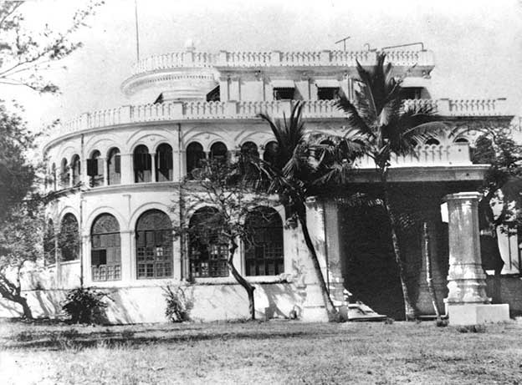
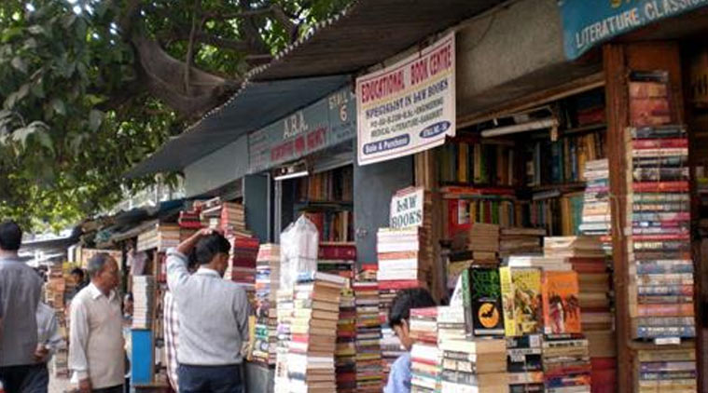
Victoria Memorial
Kumortuli
Kolkata City Tour 1950/-
(min 4 heads)
St. Paul’s Cathedral
New Market
Vivekananda’s house
College Street Boipara

Slide 2
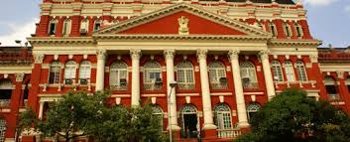
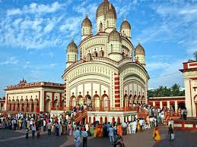
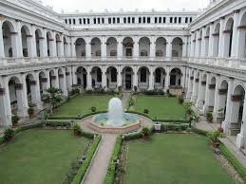
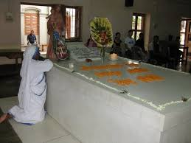
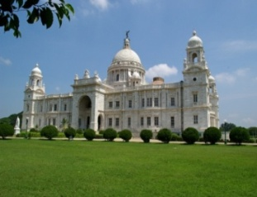
Kolkata City Tour : (Heritage City of Joy) Duration- 8 hours
Itinerary 1
Victoria Memorial, Mother Teresa’s home / Indian Museum, New Market, Dakshineswar & Belur
Itinerary 2-
Kalighat Temple, Victoria Memorial, Eden Gardens, Writers Bldg, St Pauls Cathedral, Quest Mall / South City Mall
Itinerary 3-
Kalighat temple, Victoria Memorial, Indian Museum, St Pauls Cathedral, New Market
Car details- AC Bus / Tempo Traveller and similar
NB- rates are exclusive of parking fees ,entry fees for foreigners and meals
Inclusive of general entry fees, vehicle, sightseeing and bisleri water
The itineraries can be further customised to suit your needs. Tour dates- as per your convenience

Slide 3
1950/- (min 15 heads) (5 hours)

Slide 4
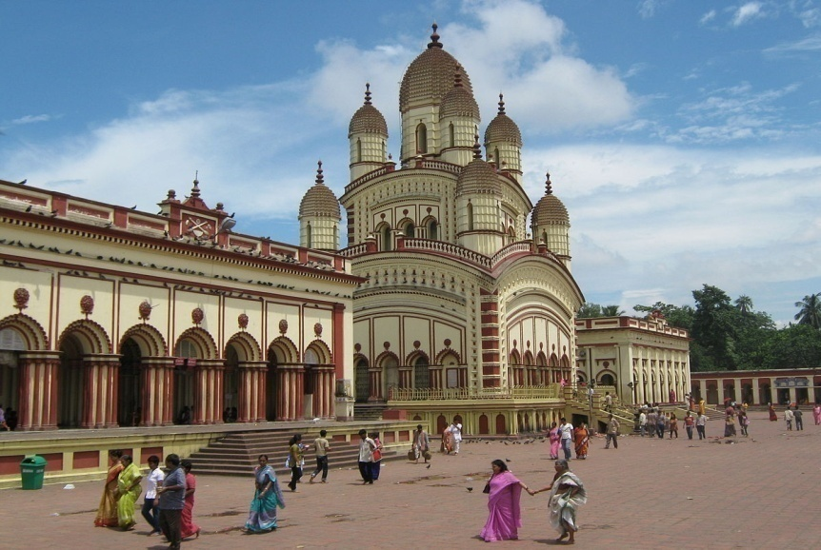
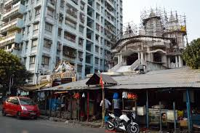
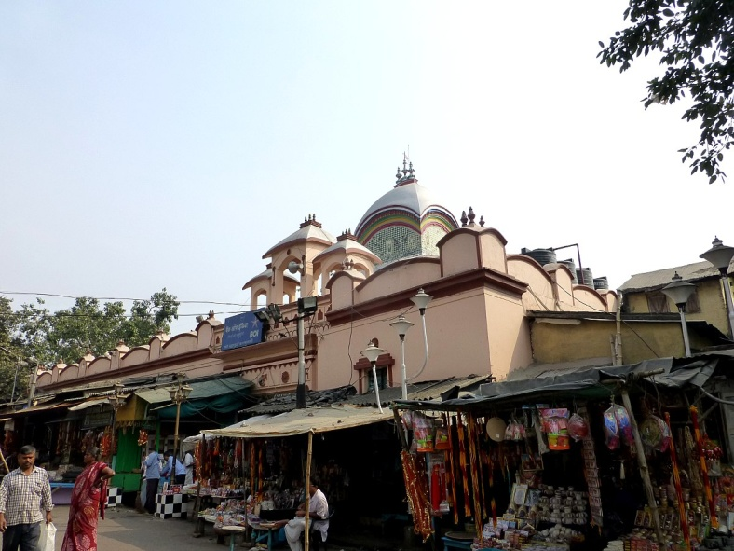
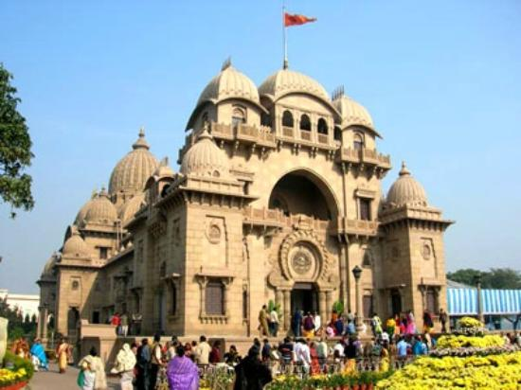
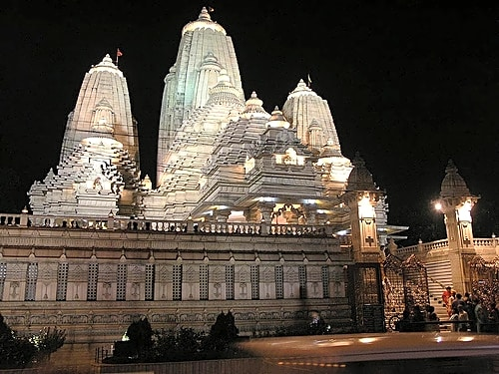
Dakshineshwar Temple
Lake Kalibari Temple
Kalighat Temple
Kolkata Temple Tour 1750/-
(min 4 heads)
Belur Math Temple
Birla Mandir Temple

Slide 5
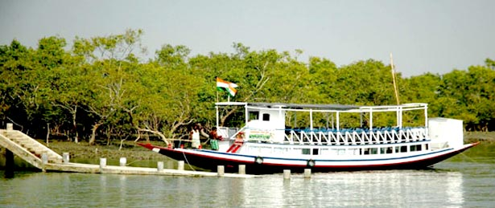
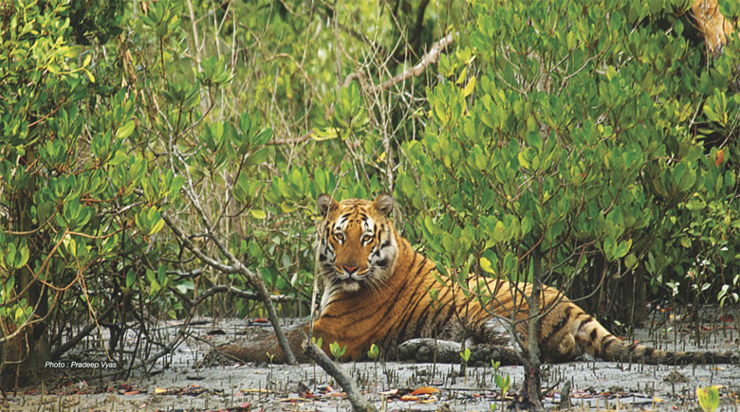
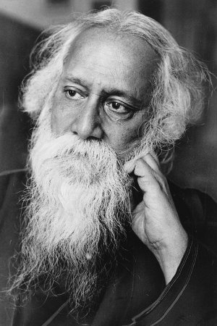
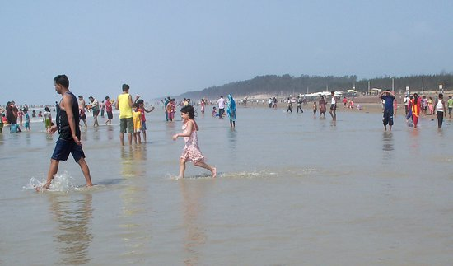
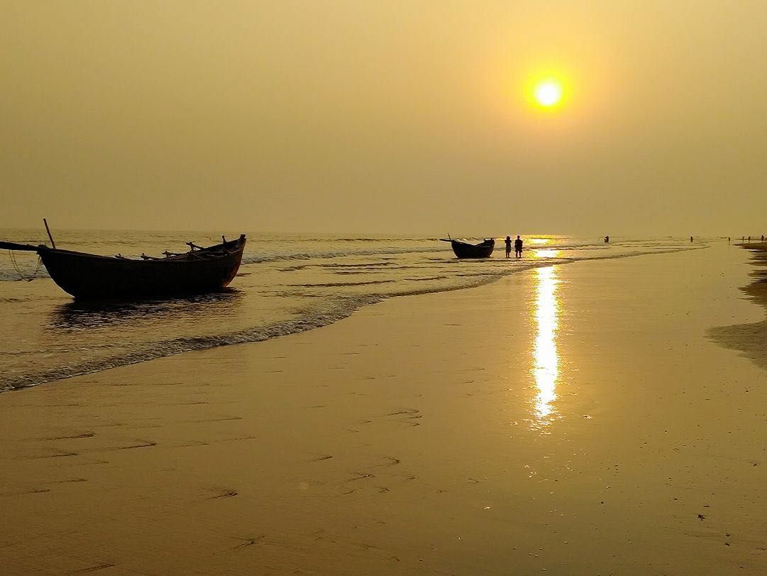
Sundarban 1850 /- (min 10 heads)
Shantiniketan 2550/- (min 6 heads)
Digha 2250/- (min 6 heads)
Mandarmani 2550/- (min 8 heads)

Slide 6
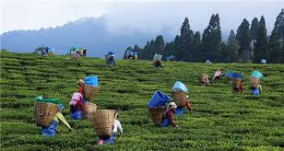
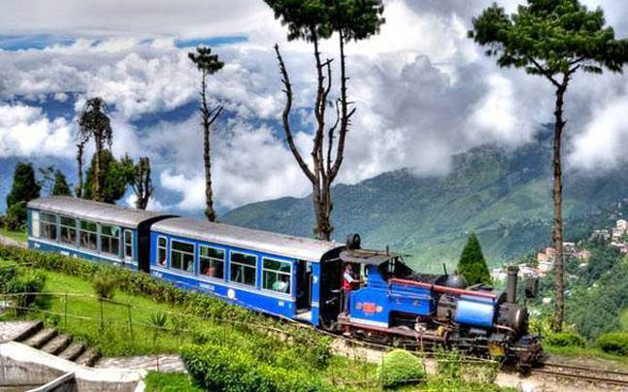
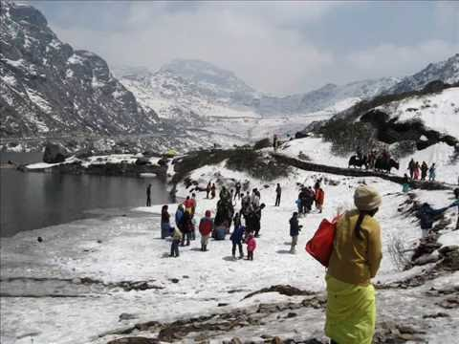
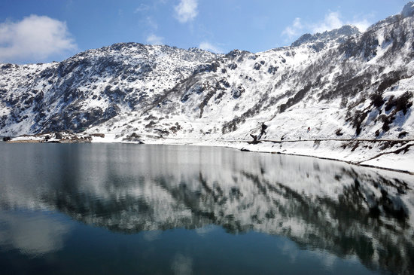
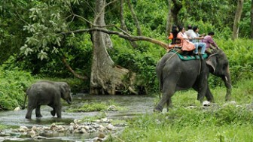
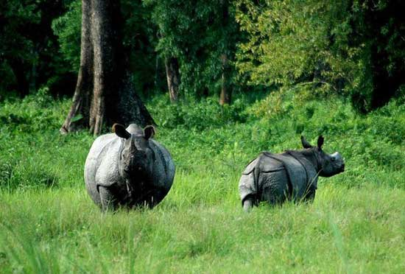
Darjeeling (3 days 2 nights) 4500/- - 10500/- (min 8 heads)
Gangtok (3 days 2 nights) 4250/- - 9500/- (min 7 heads)
Dooars (Jungle Safari) (3 days 2 nights) 2650/- (min 5 heads)

Slide 7
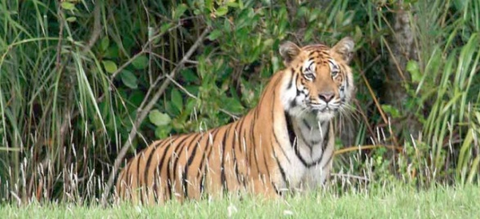
Please get in touch for more information
Temple Tiger (tour & travels)
Advance BOOKING, DISCOUNT , IMaRC 2018. M- 86177-46715, 85829-98400, 97333-10392
Mail us : templetigertravels@gmail.com
www.tttourism.in

