Slide 1
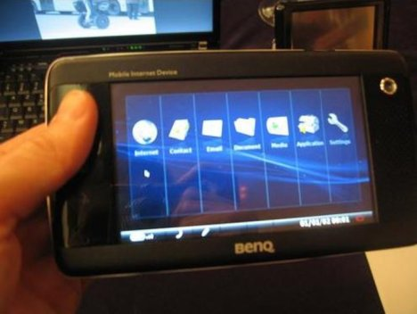

Wiki-Reality:
Augmenting Reality with
Community Driven Websites
Speaker: Yi Wu
Intel Labs/vision and image processing research
Collaborators: Douglas Gray, Igor Kozintsev, Horst Haussecker

Slide 2
Motivation
What is the best way to use what we have to access what we want?
We have:
  Mobile devices facing UI challenges … (lack of keyboard, mouse limits, small screen size, etc.)
  Mobile devices with an abundance of sensors with nothing to do... (Camera, GPS, accelerometers, 3G, etc.)
  A plethora of data from the net, indexed only by text... (Wikipedia, Wikitravel, Yelp, etc.)
We want:
  Easy access to the relevant information
  Augment the reality in front of my eyes

Slide 3
Previous/Existing Work
Just a tiny sample...
  A Touring Machine, Feiner et al. 1997
  Websigns, Pradhan et al. 2001
  SnapToTell, Lim et al. 2004
  Various Nokia Projects, Takacs, Quack et al. 2008
Hard to deploy in a large scale due to the pain of maintaining database up to date
Internet data get refreshed everyday

Slide 4
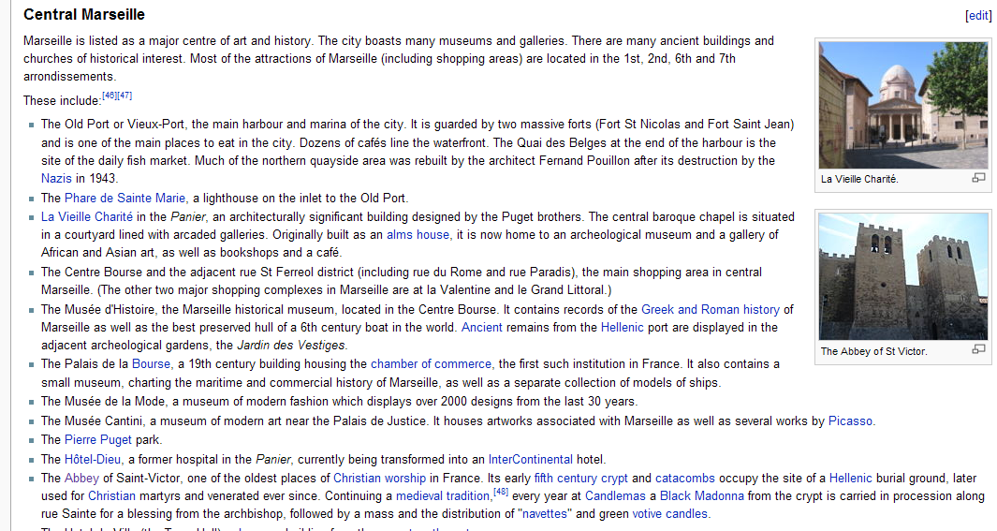
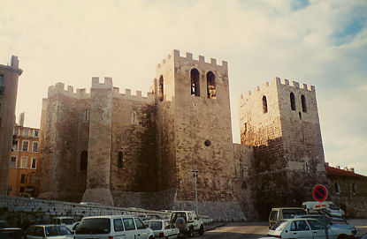
Example Scenario
You are wandering around Marseille, France and you see this building. What is it?
The Answer is on Wikipedia!
Tourist photo from Flickr
4

Slide 5
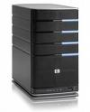


System Overview
DB
wireless link
~ 150k photos with
geo-location tags &
linked Wiki-pages
Automated
Wikipedia crawling
script extracting geo-tagged Wiki pages and pictures
Developed location
based data query &
hierarchical kmeans
indexing structure
for fast data access using visual features
Mobile device
User
Internet User

Slide 6
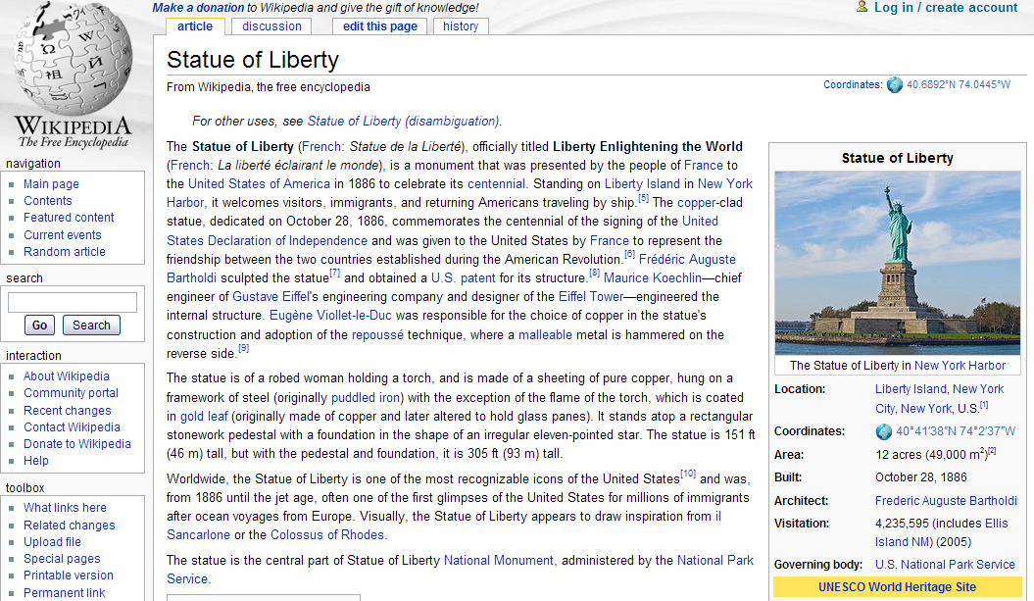
Data Collection
Images are in pages which have geo-tags...

Slide 7
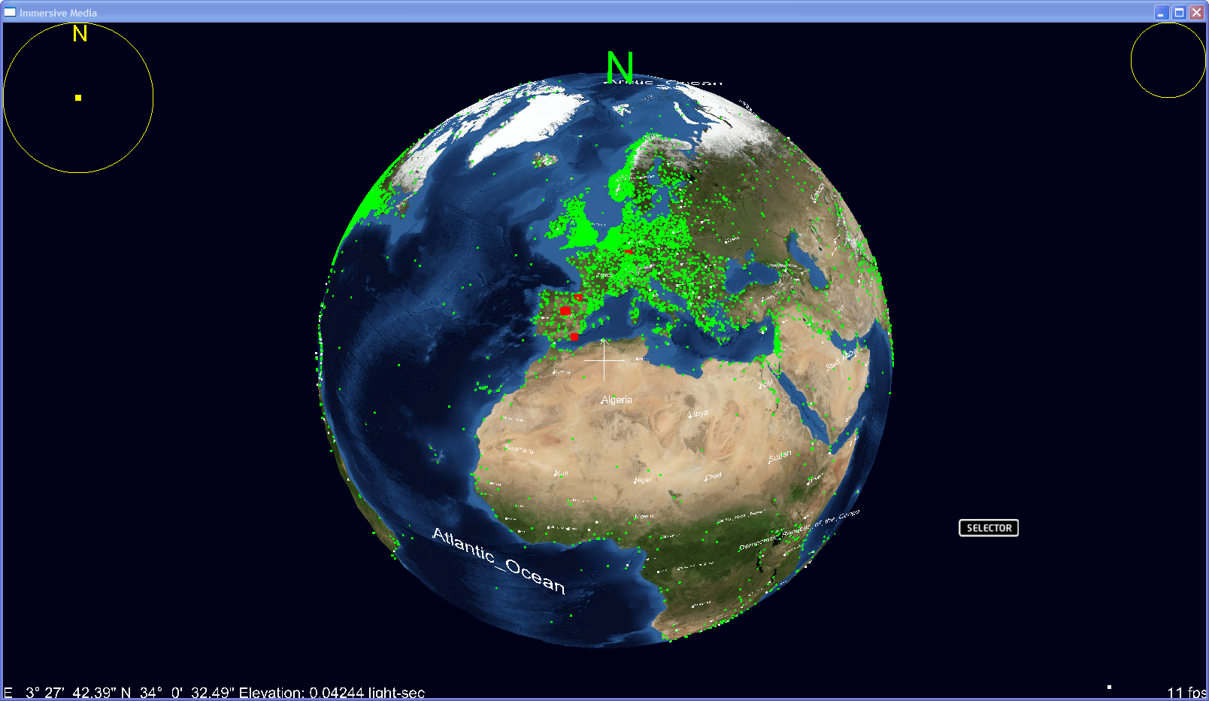
Data Distribution

Slide 8
Partition between Client and Server
Data capture
and display
Mobile Client
Visual Retrieval,
Augmentation
and Rendering
Acquire
Acquire
Extract
Extract
image
Extract
image
features
features
features
Image
Image
Acquire
Image
match
match
Sensor
match
data
Database/Server
Mobile Client
Rendering
Extract
Acquire
Extract
Track
features
image
features
image
Download
Data
data
Overlay
Notes:
For place data, Location sensor(s) used to determine location, prefetch indexes of recognized images in remote database. For objects, local data cache synched periodically

Slide 9
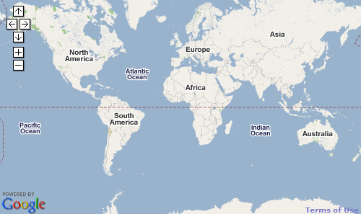
Geo-indexing Algorithm
Hierarchical Spatial Indexing
    Points are indexed at multiple levels
    Allows for efficient retrieval from very large databases
4
5
6
7
28
29
0
1
30
31
2
3

Slide 10
Visual Feature, Indexing and Matching
SURF (64d) features extracted
  Bay et al. from ECCV 2006
  Code optimization: multithreading, vectorization and descriptor quantization
Indexed with a scalable vocabulary tree
  Nister & Stewenious from CVPR 2006
  Hierarchical k-means clustering

Slide 11


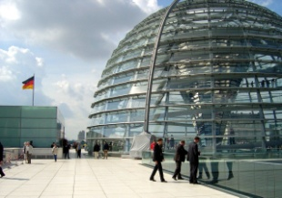
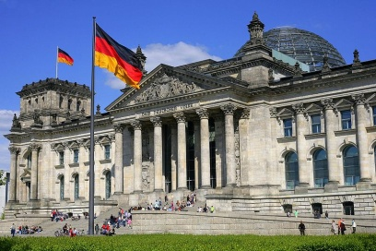
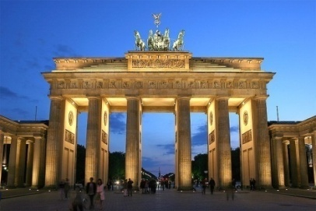
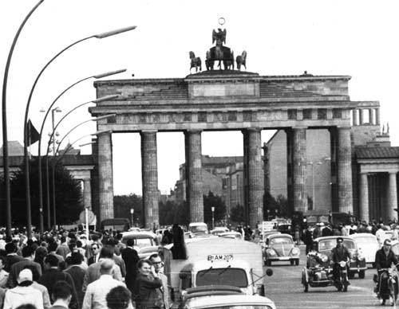
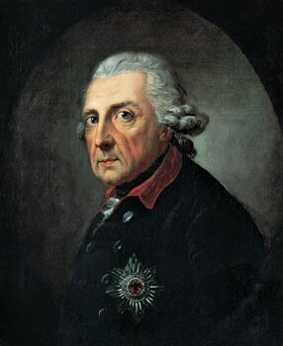
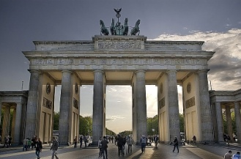
The Page/Location ↔ Image Graph
Berlin
Geo-Tag
Brandenburg Gate

Slide 12
Page Selection
Page relevance is determined with
        Number of references to that page that are found in the top n results
        Divided by the number of images in the page
Generally favors more specific pages
      “Brandenburg Gate” (3 out of 3 images) rather than “Berlin” (1 out of 6 images)

Slide 13
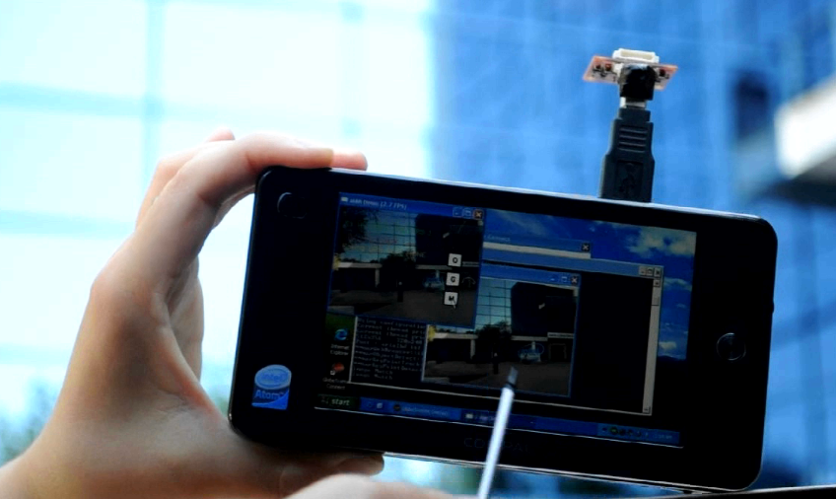
Prototype MID

Slide 14
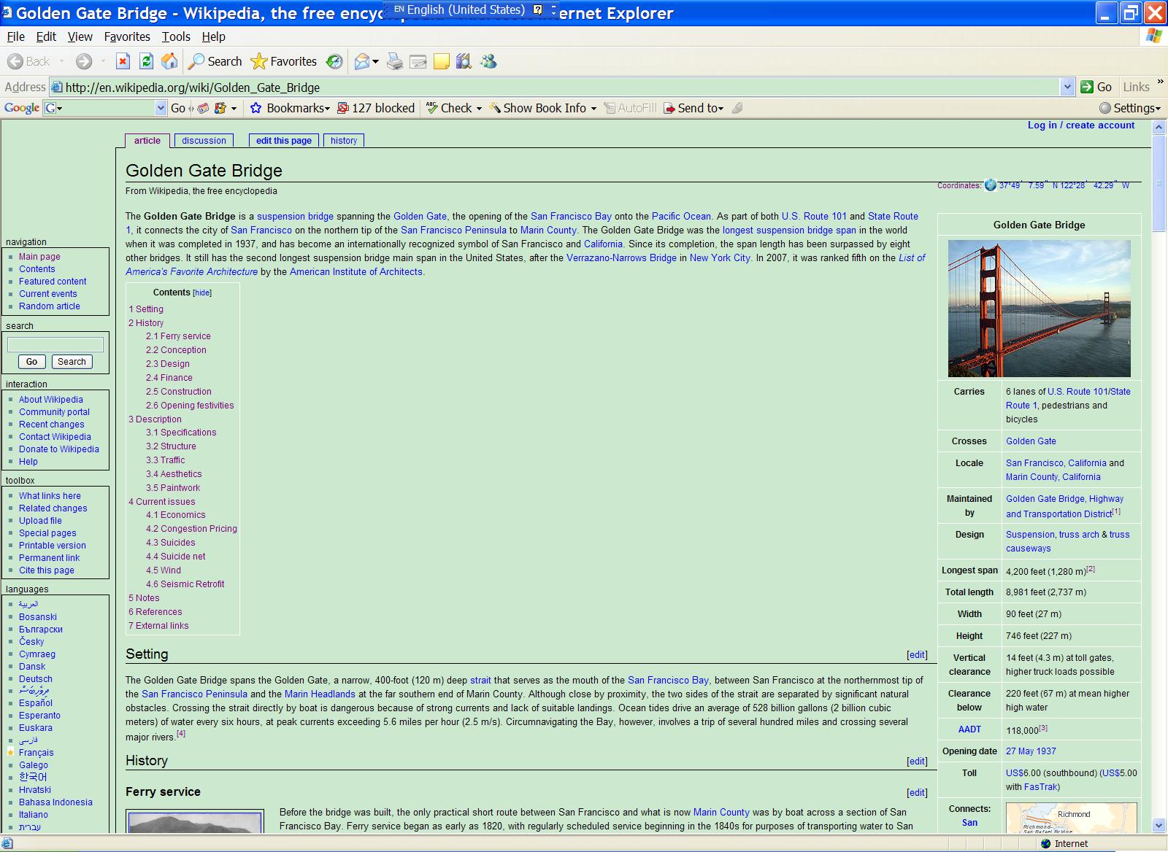
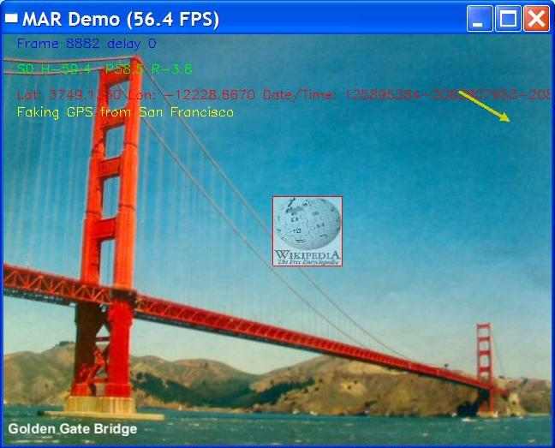
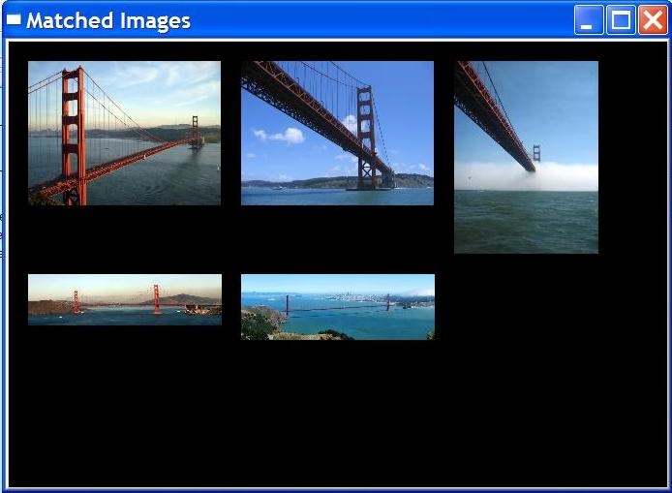
User Interface
Live video input
Top 5 image matches. Users can click on the top match to open related wikipage in the web browser
Response time is within a couple of seconds, depending on network connectivity
Notes:
MAR system uses GPS data and live camera input to correctly recognize landmark, augment live video with a thumbnail and text from wikipedia page. Orientation sensor is used to pin the icon to the object location in image and direction

Slide 15
Demo Video

