Slide 1

Scalable Interactive Search
Chen Li
Chen Li (李晨)
  Bimaple Technology
NFIC August 14, 2010, San Jose, CA
Joint work with colleagues at UC Irvine and Tsinghua University.

Slide 2
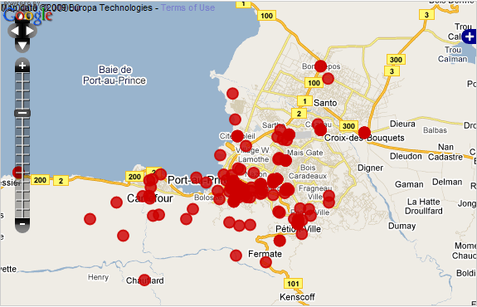
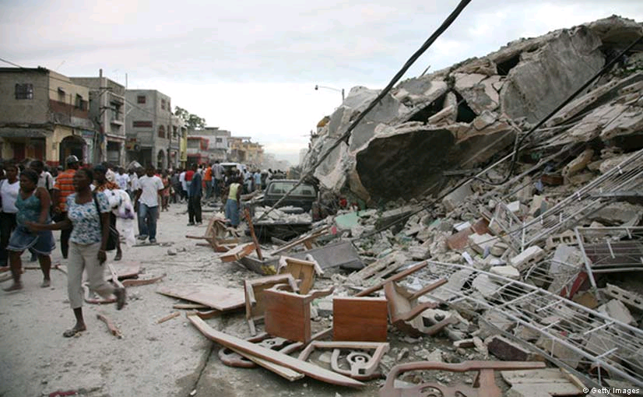
Haiti Earthquake 2010
7.0 Mw earthquake on Tuesday, 12 January 2010.
3,000,000 people affected
230,000 people died
300,000 people injured
1,000,000 people made homeless
250,000 residences and 30,000 buildings collapsed or damaged.
http://en.wikipedia.org/wiki/2010_Haiti_earthquake

Slide 3
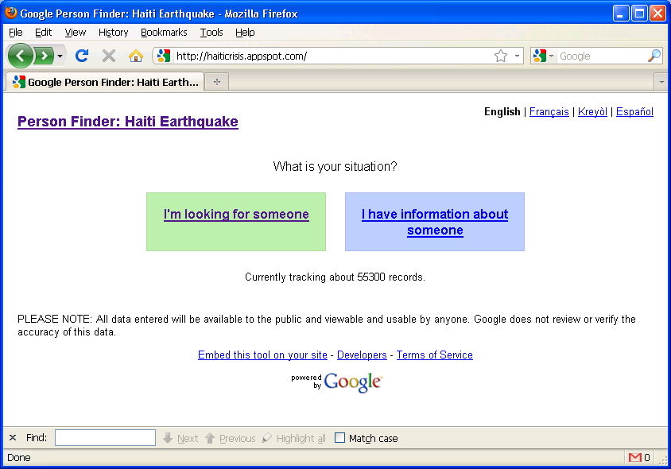
Person Finder Project
http://haiticrisis.appspot.com/

Slide 4
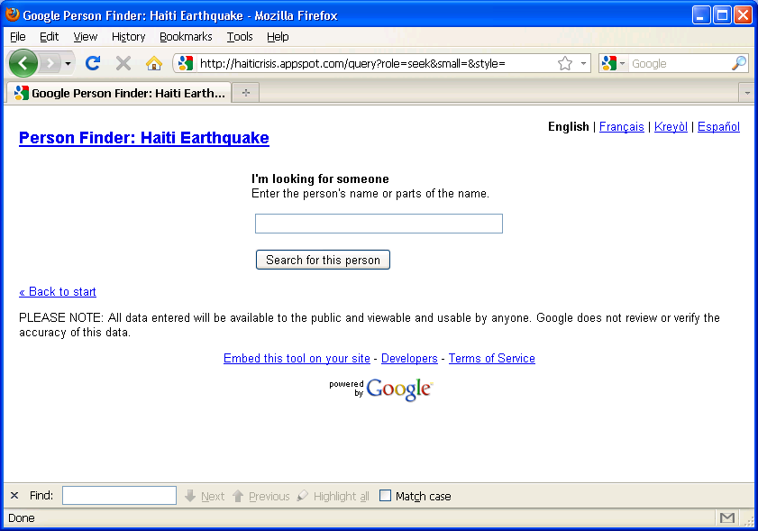
Search Interface
http://haiticrisis.appspot.com/query?role=seek&small=&style=

Slide 5
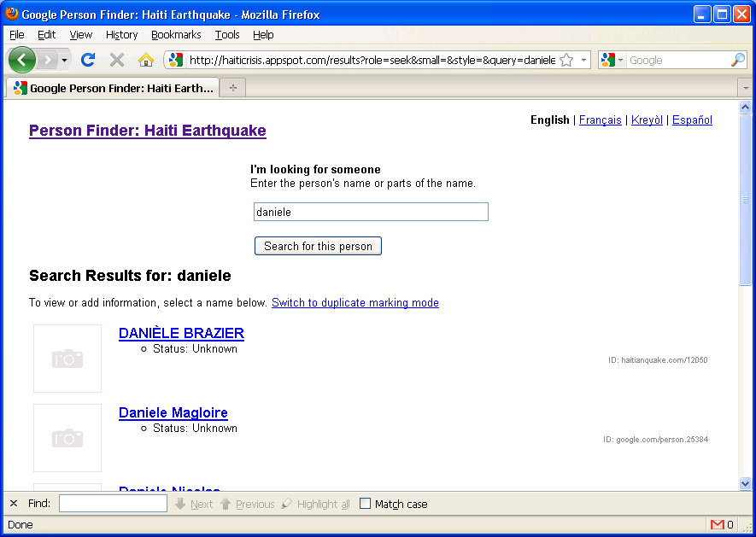
Search Result: “daniele”
http://haiticrisis.appspot.com/results?role=seek&small=&style=&query=daniele

Slide 6
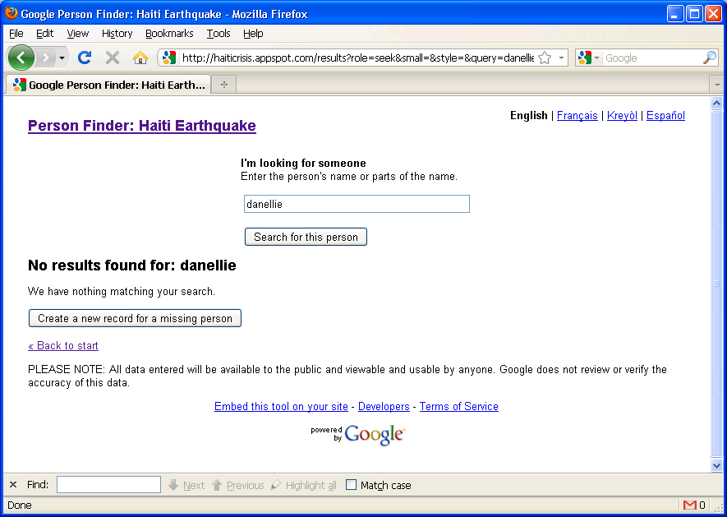
Search Result: “danellie”
http://haiticrisis.appspot.com/results?role=seek&small=&style=&query=danellie

Slide 7
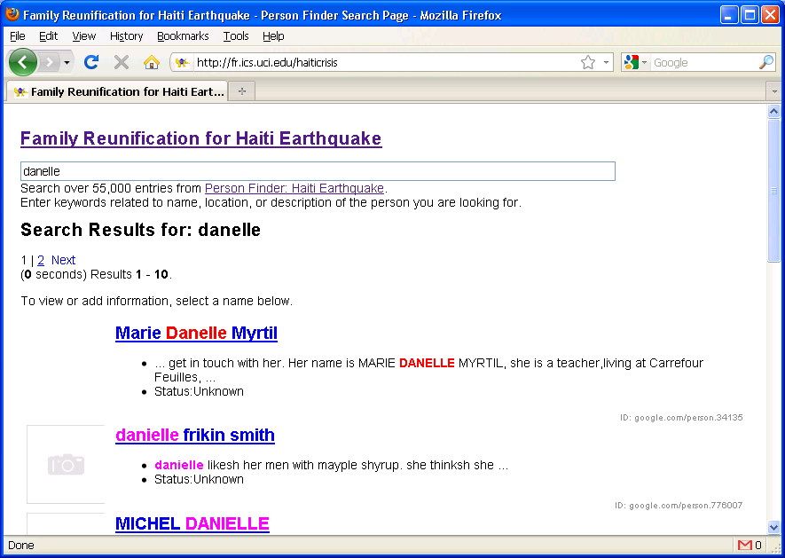
A more powerful search interface developed at UCI
http://fr.ics.uci.edu/haiticrisis

Slide 8
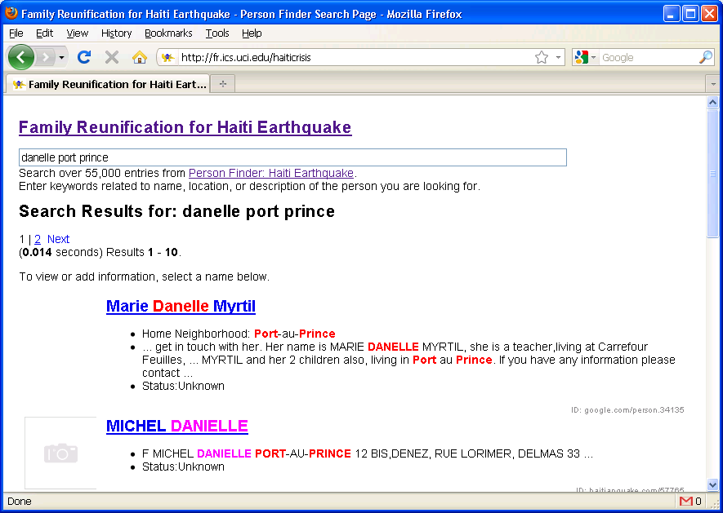
Full-text, Interactive, Fuzzy Search
http://fr.ics.uci.edu/haiticrisis

Slide 9
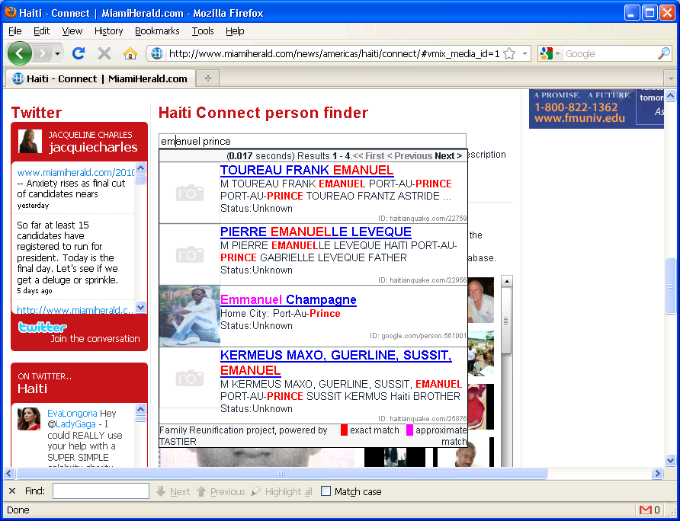
Embedded search widget (a news site in Miami)
http://www.miamiherald.com/news/americas/haiti/connect/

Slide 10
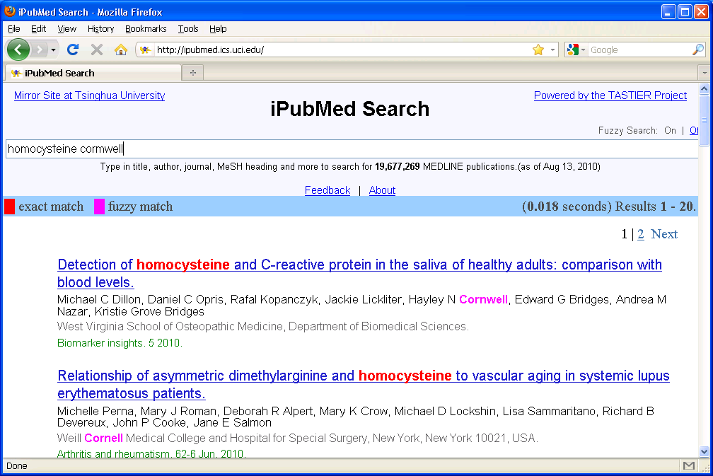
Scalability demo: iPubMed on 19M records
http://ipubmed.ics.uci.edu

Slide 11
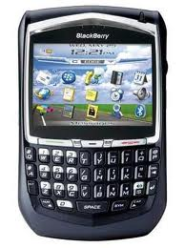
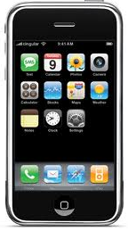
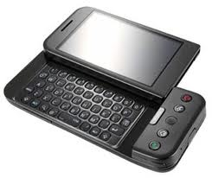
Interactive Search
  Find answers as users type in keywords
  Powerful interface
  Increasing popularity of smart phones

Slide 12
Outline
A real story
Challenges of interactive search
Recent research progress
Conclusions

Slide 13


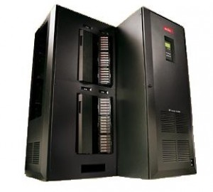
Challenge 1: Number of users
  Single-user environment
  Multi-user environment

Slide 14
Performance is important!
< 100 ms: server processing, network, javascript, etc
Requirement for high query throughput
  20 queries per second (QPS) → 50ms/query (at most)
  100 QPS → 10ms/query

Slide 15
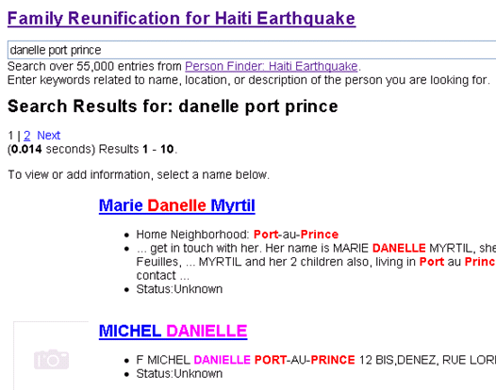

Challenge 2: Query Suggestion vs Search
  Query suggestion
  Search

Slide 16
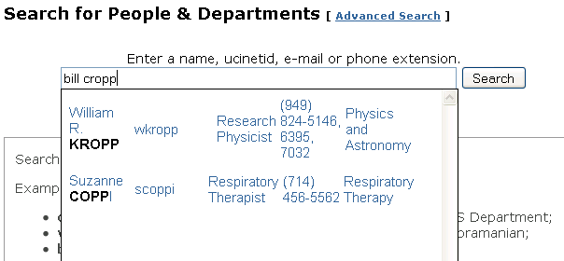
Challenge 3: Semantics-based Search
Search “bill cropp” on http://psearch.ics.uci.edu/

Slide 17
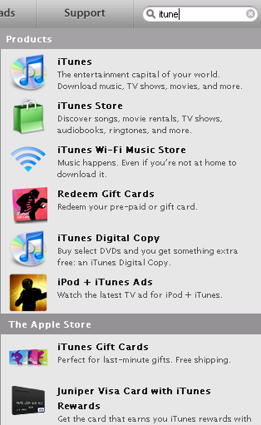
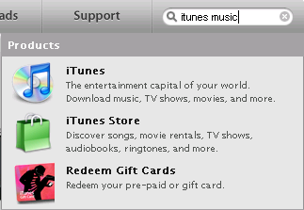
Challenge 4: Prefix search vs full-text search
Query: “itunes music”
Search on apple.com
Query: “itune”

Slide 18
Outline
A real story
Challenges of interactive search
Recent research progress
Conclusions

Slide 19


Recent techniques to support two features
Fuzzy Search: finding results with approximate keywords
Full-text: find results with query keywords (not necessarily adjacently)

Slide 20
Edit Distance
Ed(s1, s2) = minimum # of operations (insertion, deletion, substitution) to change s1 to s2
s1: v e n k a t s u b r a m a n i a n
s2: w e n k a t s u b r a m a n i a n
ed(s1, s2) = 1
20
Notes:
20

Slide 21
Problem Setting
Data
  R: a set of records
  W: a set of distinct words
Query
  Q = {p₁, p₂, …, p_{l}}: a set of prefixes
  δ: Edit-distance threshold
Query result
  R_{Q}: a set of records such that each record has all query prefixes or their similar forms

Slide 22
Feature 1: Fuzzy Search

Slide 23
Formulation
Query:
wenkatsubra
Record Strings
carey
jain
nicolau
smith
venkatasubramanian
Find strings with a prefix similar to a query keyword
Do it incrementally!

Slide 24
Trie Indexing
Computing set of active nodes Φ_{Q}
  Initialization
  Incremental step
e
s
x
a
a
e
m
Active nodes for Q = example
m
m
p
Prefix | Distance
examp | 2
exampl | 1
example | 0
exempl | 2
exempla | 2
sample | 2
$
p
2
p
l
l
1
l
2
t
e
2
e
0
a
2
$
$
$
r
$

Slide 25
Initialization and Incremental Computatin
Q = ε
0
Prefix | Distance
Prefix | Distance
 | 0
e | 1
ex | 2
s | 1
sa | 2
Prefix | Distance
ε | 0
e
1
s
1
x
2
a
2
a
e
m
m
m
p
$
p
p
l
l
l
t
e
Initializing Φ_{ε} with all nodes within a depth of δ
e
a
$
$
$
r
$

Slide 26
Feature 2: Full-text search
Find answers with query keywords
Not necessarily adjacently

Slide 27
Multi-Prefix Intersection
ID | Record
1 | Li data…
2 | data…
3 | data Lin…
4 | Lu Lin Luis…
5 | Liu…
6 | VLDB Lin data…
7 | VLDB…
8 | Li VLDB…
d
l
v
a
i
u
l
t
$
n
u
$
i
d
a
1
8
$
$
4
s
b
$
3
4
6
5
$
$
1
2
3
6
4
6
7
8
Q = vldb li
li
1 3 4 5 6 8
vldb
6 8
6 7 8
More efficient algorithms possible…

Slide 28

Conclusions
Interactive Search: Kill the search button ☺

Slide 29
Thank you!
Chen Li
http://tastier.ics.uci.edu/

